Slide 1
Unit 203: Electrical installations technology
Earth loop impedance

Slide 2
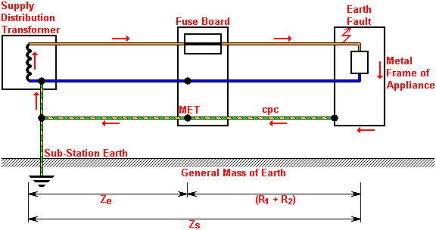
Earth loop impedance
The loop comprises the following parts, starting at the point of the fault:
circuit protective conductor
the main earthing terminal (MET) and earthing conductor
for TN‑S systems, the supply earth
the path through the earthed neutral point of the supply transformer
the source line winding
the line conductor from the source to the point of the fault.
The impedance of this fault path, ie the ‘earth fault loop impedance’, is denoted by the symbol Z_{s} and is measured in ohms (Ω).

Slide 3
Earth loop impedance
The fault path is broken into two parts:
the external impedance (Z_{e}) comprises combined resistances/impedances of the fault path on regional supply company’s (REC) side of the supply intake
the combined resistance of the consumers’ line conductor (R₁) and the consumers’ cpc conductor (R₂). This combined resistance is referred to as (R₁ + R₂).
Both of these value combined is the earth loop impedance (Z_{s}) and is measured in ohms (Ω)

Slide 4
Earth loop impedance
TN-S system

Slide 5
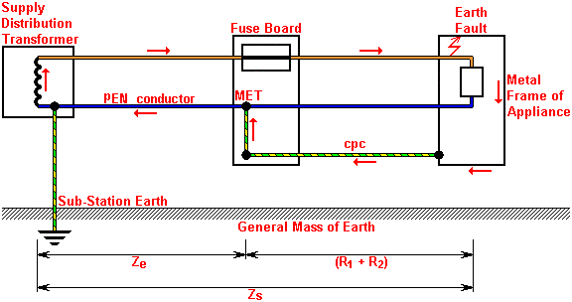
Earth loop impedance
TN-C-S system

Slide 6
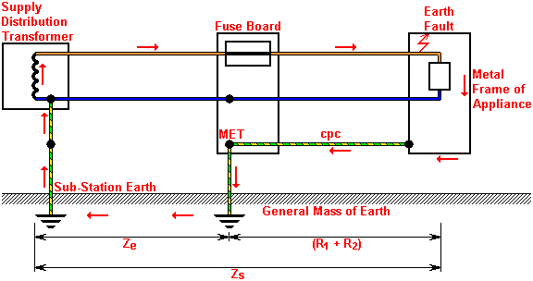
Earth loop impedance
TT system

Slide 7
Unit 203: Electrical installations technology
The End

